Slide 1
THE NATURE OF IT PROJECTS
Aris J. Ordoñez, DIT

Slide 2
LECTURE OBJECTIVE
Describe the Software Crisis and how the often dismal track record for information technology projects provides a motivations for changing how we view and manage IT projects.
Explain the socio-technical, project management, and knowledge management approaches that support ITPM
Define what an IT project is and describe its attributes
Define the discipline called project management
Describe the role and impact IT projects have on an organization
Identify the different roles and interests of project stakeholders
Describe the project life cycle, the systems development life cycle, and their relationship
Identify the Project Management Body of Knowledge PMBOK and its core knowledge areas

Slide 3
CASE ANALYSIS
You are the Owner/CEO of a Software Development Company (YDKW Inc.). You received a call from a target client that they are interested in getting your services for the development of an information that they need. This is the break that you are waiting for, and the excitement that you feel is unexplainable. Your first big time client. However, YDKW Inc. before signing the contract would like to know the deliverables, the cost, and the completion date.
As the project manager, you know how important is getting the contract and a successful project would surely lead another potential clients.
You have been working with lots of projects now, but not as big as this one. The outcome of this project is a make or break for your company.

Slide 4
WHAT WOULD YOU THINK?
WHAT WOULD YOU FEEL IN THIS SITUATION?
WHAT QUESTIONS WOULD YOU HAVE?
WHAT THINGS MIGHT HELP REDUCE YOUR ANXIETY AND UNCERTAINTY AS AN INEXPERIENCED PROJECT MANAGER?
WHERE DO YOU BEGIN A NEW PROJECT?

Slide 5
THE SOFTWARE CRISIS
IT is becoming more reliable, faster, and less expensive, the cost however, complexities, and risks of IT projects continue to increase.
US spent billions each year on IT application development project, but 31% of these projects were cancelled before completion. 53% were completed, but were over-budget and over schedule, and did not meet the original specifications.
Average cost overrun – 182%
Average schedule overrun – 202%
48% of IT managers believed there were more failures than 5 and 10 years earlier
Conducted by Standish Group (survey is called CHAOS)

Slide 6
Why IT Projects fails?
Top Factors ensuring IT project success
User involvement
Executive Management Support
Clear statement of the Requisites
Main Factors why projects are challenged or cancelled
Lack of user involvement
Incomplete Requirments

Slide 7
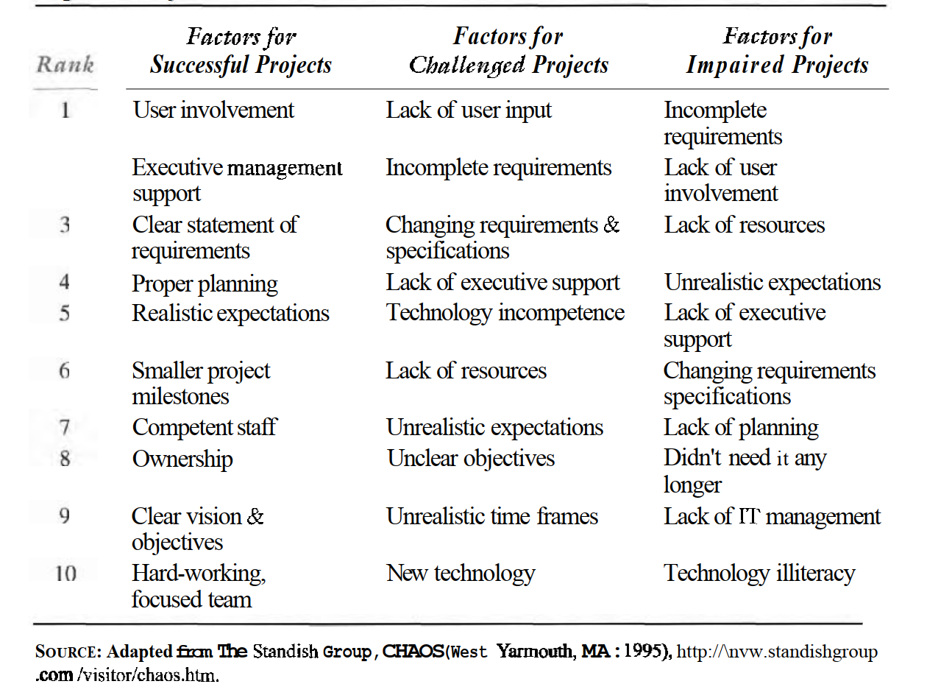

Slide 8
Improving the Likelihood of Success
A Socio-Technical Approach – improves the chance by focusing on the tools, techniques, methodologies of IT development.
A purely technical approach which focuses more on technology may end up developing an application that no one asked for or needs.
IT Professionals must understand the business and be actively creative in applying the technology in ways that brings value to the organization.
Similarly, the clients must become stakeholders in the project.
The successful application of technology and the achievement of the project’s goal must be an equal responsibility of the developers and users.

Slide 9
Improving the Likelihood of Success
A Project-Management Approach – the need for a better project management.
Project management must define who is, or is not, part of the project team.
Should apply project management principles and tools across the organization.
Step-by-step activities, processes, tools, quality standards, controls, and deliverables should be clearly defined.
What defines the success of the project are the set of processes and infrastructures in place.

Slide 10
Improving the Likelihood of Success
OTHER CONSIDERATIONS
Resources – Tools and processes for monitoring resources should be in place
Expectations – Timely status updates and communication, as well as sound project management practices for delivering expectations are required
Competition – competitions may exist inside the organization, within the team, or against other competitors (IT companies)
Efficiency and Effectiveness -

Slide 11
Improving the Likelihood of Success
A Knowledge Management Approach – a systematic process for acquiring, creating, synthesizing, sharing, and using information, insights, and experiences to transform ideas into business value.
Learning from experience is the best guide towards success.
These experiences however are fragmented throughout the organization
There are chances that your problem was already solved by somebody else and dealt with it. That person however may be from the other side of the world.
Knowledge and experience in the form of lessons learned, can be documented and made available throughout the technologies available today.

Slide 12
Improving the Likelihood of Success
Give examples of Knowledge and Experience in the form of lessons learned:
?
?
?
?
?

Slide 13
Project Management
What is a Project?
Is a temporary endeavor undertaken to accomplish a purpose.
What is Project Management?
Is the application of knowledge, skills, tools, and techniques to project activities in order to meet or exceed stakeholder needs and expectations from the project.

Slide 14
Attributes of a Project
Time Frame – Since project is a temporary endeavor, it must have a beginning and end. Must begin on a specific date and the date completion is estimated.
Purpose – Projects are undertaken to accomplish something. It can produce any number of results, a system, a software package, or a recommendation based on study. The project’s goal must be tangible and of value to the organization.
Ownership – The project must provide something of value to an individual or group who will own the project’s product after it is completed.

Slide 15
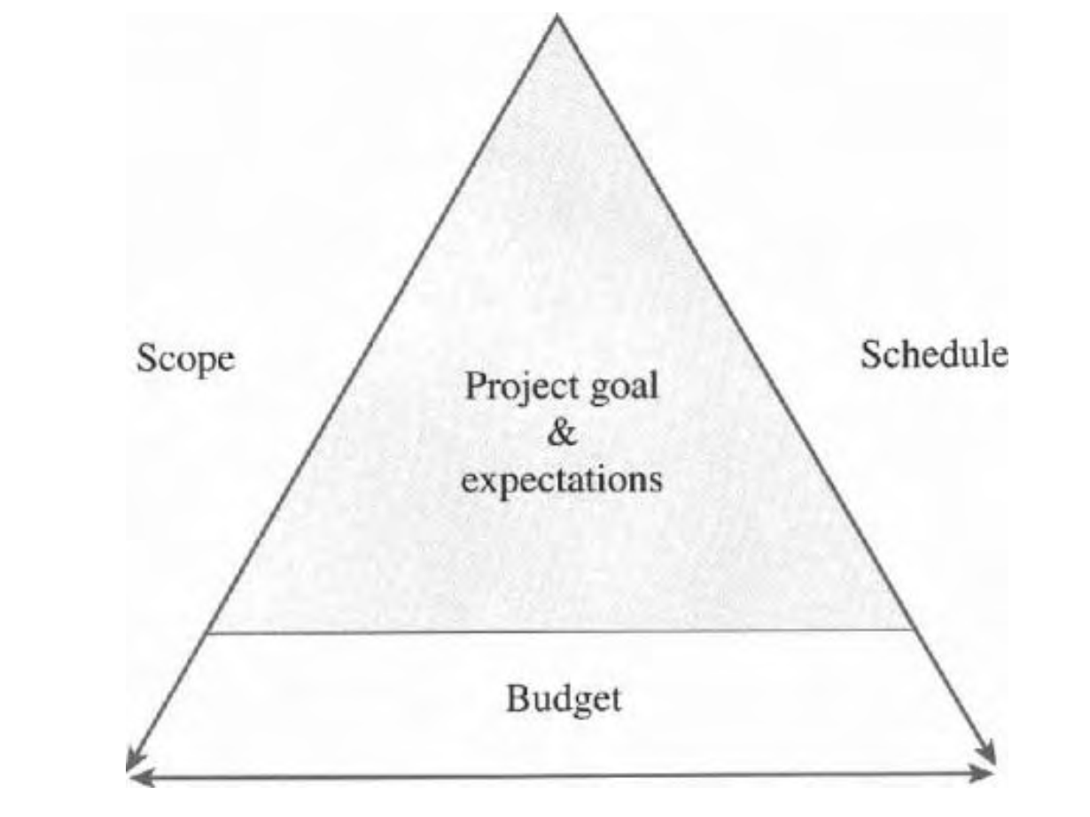
Attributes of a Project
Resources – IT Projects require time, money, people, and technology. Resources provide the means for achieving the project’s goal and also act as a constraint.
If scope increases, the schedule and budget must increase accordingly, if the project’s schedule and resources are fixed, the only way to decrease cost or schedule of the project is to reduce the project scope.
Scope, schedule, and budget must remain in an equilibrium to support the project goal.
The Triple Constraint

Slide 16
Attributes of a Project
Roles – IT projects require different individuals with different skill sets. Typical project may include the following:
Project Manager (Project Management, development processes, quality standards)
Project Sponsor (client, customer, manager)
Subject Matter Expert (client with specific knowledge, expertise, insight of functional area to support the project)
Technical Expert (system analyst, network specialist, programmers, graphic artist, trainers)

Slide 17
Attributes of a Project
Risks and assumptions – All projects have an element of risks, and some projects entail more risk than others. May arise from both internal and external to the project team. Assumptions are used to estimate scope, schedule, and budget. It is also used to assess the risk of the project.
Interdependent Tasks – Project requires many interdependent tasks. Example: a network cannot be installed until the hardware is delivered. A requirement cannot be incorporated into the design until the key user is interviewed.

Slide 18
Attributes of a Project
Organizational Change – Projects are planned organizational change. Change must be understood and managed because implementation of the IT project will change the way people work. The potential of resistance exists and the system that is technical success could end up being an organizational failure.
Operating in an environment larger that the project itself – It is important the project manager and team understand the company’s culture, environment, politics, and the like. These variables will influence the selection of the projects, the IT infrastructure, and the role of the IT within the organization.

Slide 19
Project Life Cycle and IT Development
The Project Life Cycle (PLC) – a collection of logical stages of phases that maps the life of a project from its beginning to its end in order to define, build, and deliver the product of a project.
Like all living things, projects have life cycles where they are born, grow, peak, decline, and then terminate.
Project Life Cycles may differ but generally they have beginning, middle, and end.

Slide 20
Project Life Cycle and IT Development
Define Project Goal
Gives clear focus and drives the other phases of the project
Plan Project
What to do? Why do it? How? Who will do it? How long? How much? What can go wrong? How to know when it’s done?
Execute Project Plan
Put to action, monitor progress, manage scope, schedule, budget
Close Project
Ensure all works are completed
Evaluate Project
Determines the value of the project. Could be done by cross checking with the expected deliverables or its response to the actual environment

Slide 21
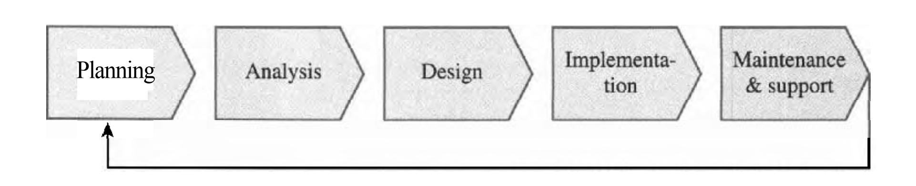
The SDLC
The System Development Life Cycle is the most common Product Life Cycle in IT.
It represents the sequential phases or stages an information system follows throughout its useful life.
It establishes a logical order or sequence in which the system development activities occur and indicates whether to proceed from one system development activity to the next.
Planning, Analysis, Design, Implementation, and Maintenance & Support are the five (5) basic phases in the system development life cycle.

Slide 22
Putting SDLC into Practice
Different ways of implementing SDLC
Structured Approach to Systems Development
this is applicable systems were relatively simple and independent with each other
Computer Hardware was relatively expensive than the labor
Development and Programming tools were primitive compared to today
The Waterfall Method follows the SDLC in a very sequential and structure way.
This approach is suitable when developing structured systems and assumes or at least hope that the requirements defined in the analysis stage do not change very much over the remainder of the project
Rapid Application Development
Less structured approach to developing systems.
Takes less time to conceive, develop, and implement an Information System can provide the organization with a competitive advantage.
Larger projects that take longer to develop are riskier than smaller and shorter projects.

Slide 23
Putting SDLC into Practice
RAD’s different iterative approach
Prototyping – the developer and user works together and closely to develop a partially or fully functional system as soon as possible. The prototype application will go through a number of iterations as functional requirements are defined or changed.
Spiral Development – provides risk-oriented approach where the software project is broken up into number of mini projects where each addresses one or more major risks until all major risks have been addressed
Extreme Programming – the system is transferred to the users in a series of versions called releases. A release may be developed using several iterations and should be developed and tested within a few weeks or months. Each release is a working system that only includes one or several functions that are part of the full system specifications.

Slide 24
PLC vs SDLC
PLC and SDLC are quite similar, however the PLC focuses on the processes of managing the project while the SDLC focuses on creating and implementing the product or the Information System.
SDLC is really part of the PLC because many of the activities for developing the information system occur during the execution phase.
The last two stages of the PLC, closing and evaluating the project, occur after the implementation of the Information System

Slide 25
PMBOK
The Project Management Body of Knowledge defines nine knowledge areas for understanding project management. These nine knowledge areas are:
Project Integration Management – Focuses on coordinating the project plan’s development, execution, and control of changes
Project Scope Management – provides assurance that the project’s work is defined accurately and completely and that is completed as planned
Project Time Management – includes identifying project’s phases and activities and then estimating, sequencing, and assigning resources for each activity to ensure the project’s scope and objectives are met
Project Cost Management – assures that the project’s budget is developed and completed as approved

Slide 26
PMBOK
Project Quality Management – focuses on planning, developing, and managing a quality environment that allows the project to meet or exceed stakeholder needs and expectations
Project Human Resource Management – focuses on creating and developing the project team as well as understanding and responding appropriately to the behavioral side of project management
Project Communications Management – entails communicating timely and accurate information about the project to the project’s stakeholders.
Project Risk Management – it concerned with identifying and responding appropriately to risks that can impact the project.
Project Procurement Management – makes certain that the resources needed by the project are acquired properly

Slide 27
Next Topic Conceptualizing and Initializing the IT Project
Thank You!

